Slide 1

Understanding Acute Exercise Response among Girls and Young Women with and without Eating Disorders
Katherine Schaumberg

Slide 2
Objectives
Make a case for the study of in-vivo exercise in those with EDs
Present preliminary data on acute exercise response among those with restrictive-spectrum EDs.
Set the stage for future research on acute exercise assessment and in-vivo exercise intervention

Slide 3
Maladaptive exercise is present in the general population of adolescents and very common among those with EDs

Slide 4
Background
Common Definitional Components of Maladaptive Exercise:
Feeling ‘driven’ to preform exercise
Having exercise obsessions
Exercising to reduce distress (e.g. guilt, anxiety)
Exercising to prevent weight gain
Exercise leading to functional impairment
It is unclear which features are most salient to the reinforcement of maladaptive exercise; Little is known about in the moment exercise experience
Notes:
Weak central coherence – perseveration on details/absence of big picture

Slide 5

Why Study Acute Exercise?
Momentary affect regulation is proposed as a driving mechanism of exercise symptom maintenance
Search for translational insights connecting biological and psychological impacts of exercise
Advance understanding of ideographic differences in exercise response
Set the stage for in-vivo exercise-based treatments

Slide 6
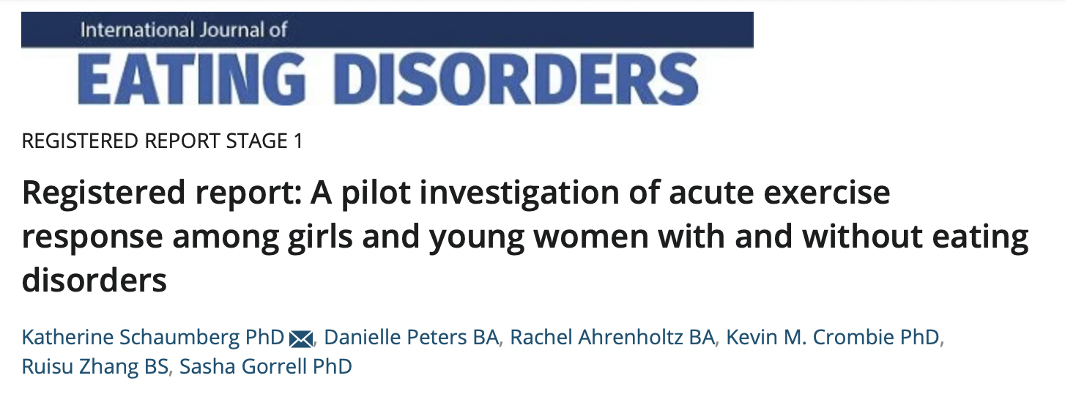
Current Project
Aim 1: Confirm feasibility of paradigms evaluating acute response to exercise among outpatient individuals with EDs. a) study dropout, b) adverse events, c) completion rates
Aim 2: Characterize variability in biobehavioral response to in-lab exercise.
2a. Characterize changes during exercise in state body image, mood, and biological markers in both ED and HC groups. (*Graphical Description and Effect size estimation)
2b. Identify potential correlates of exercise response (*Associations with CET)

Slide 7





Study Procedures
DAY A: Prescribed Exercise Task - Rest Condition; Self-Paced Exercise - Exercise Condition
DAY B: Prescribed Exercise Task - Exercise Condition
State Measures
State Measures
30-min prescribed exercise
30-min Rest
Affect, Body Image
Affect, Body Image
Biomarker
Biomarker
Behavioral
DA, eCB, 5-HT, leptin, cortisol
Behavioral
DA, eCB, 5-HT, leptin, cortisol
Work for exercise
Work for $
Affect
Body Image
HR
Distance
Exertion
Affect
Body Image
Biomarker
Biomarker
DA, eCB, 5-HT, leptin, cortisol
DA, eCB, 5-HT, leptin, cortisol
30-min self-paced exercise
HR
Distance
Exertion
Affect
Body Image
DAY C: Self-paced Exercise Task - Rest Condition
Affect, Body Image
30-min Rest
State Measures
Affect, Body Image
Affect
Body Image
Affect, Body Image
State Measures
Affect, Body Image
Note. Day A-C order is randomized. Accelerometer-measured free-living activity; self-reported DEx; ED symptoms; anxiety and personality measures collected at screening; additional state self-report measures collected during Day C
Notes:
Acute exercise response
-Intro importance of exercise in EDs; significance; need to better understand for treatment how, how much, for whom.
-Not all individuals with EDs report DEx
-Amount of exercise not as important as psychological relationship with Ex
-we want individuals with EDs to be able tot have more normative relattionsihps with ex
-two main mechanisms that may influence risk for DEx, which I’ll talk about more on the next slide-threat and reward
Day A
Progressive ratio task – 50, 100, 250, etc. for $3
“exercise reward task” – baseline reward responding
Markov – measure of reward response that requires model-based learning and PFC engagement
Ex threat task – for many people getting to drink a milkshake is exciting, not necessarily for those with EDs,
This would be a threatening experience
Engage threat-based systems
Remember back to my job talk – fear and anxiety are relevant for eating disorder risk and maintenance. And the core/central fear among EDs is fear of weight gain.
This task is designed to specifically engage this fear of weight gain
Determine response to this disorder-relevant, threat-based engagement
Determine how effective exercise is in reducing self-reported negative affect and body image

Slide 8
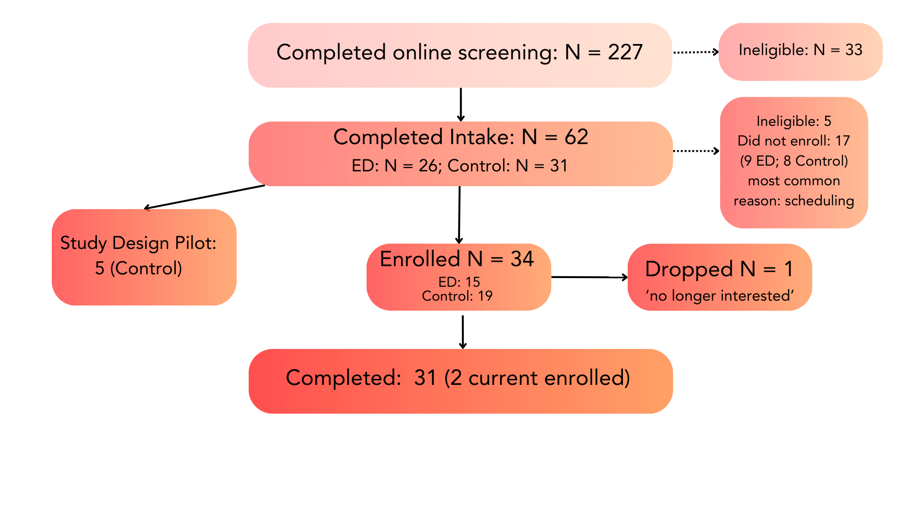
Pilot Participants (through 9/1/2023)

Slide 9
Feasibility Summary
Feasibility Strengths | Barriers
Strong participant interest | Mild recruitment resistance from clinics
>95% study completion of enrolled participants | Some discomfort with blood draw
No concerns with completion of exercise or food challenge tasks; No adverse events | Relatively high study burden (*in person)

Slide 10
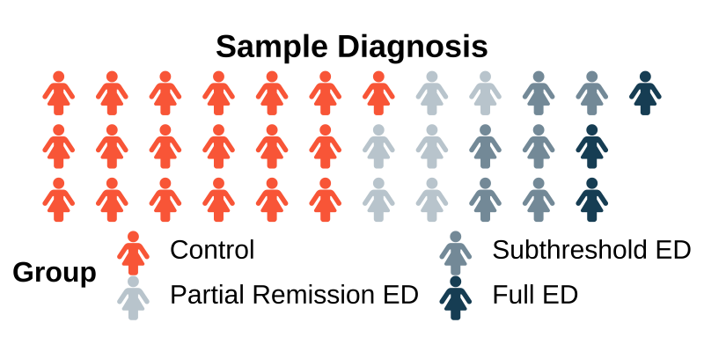
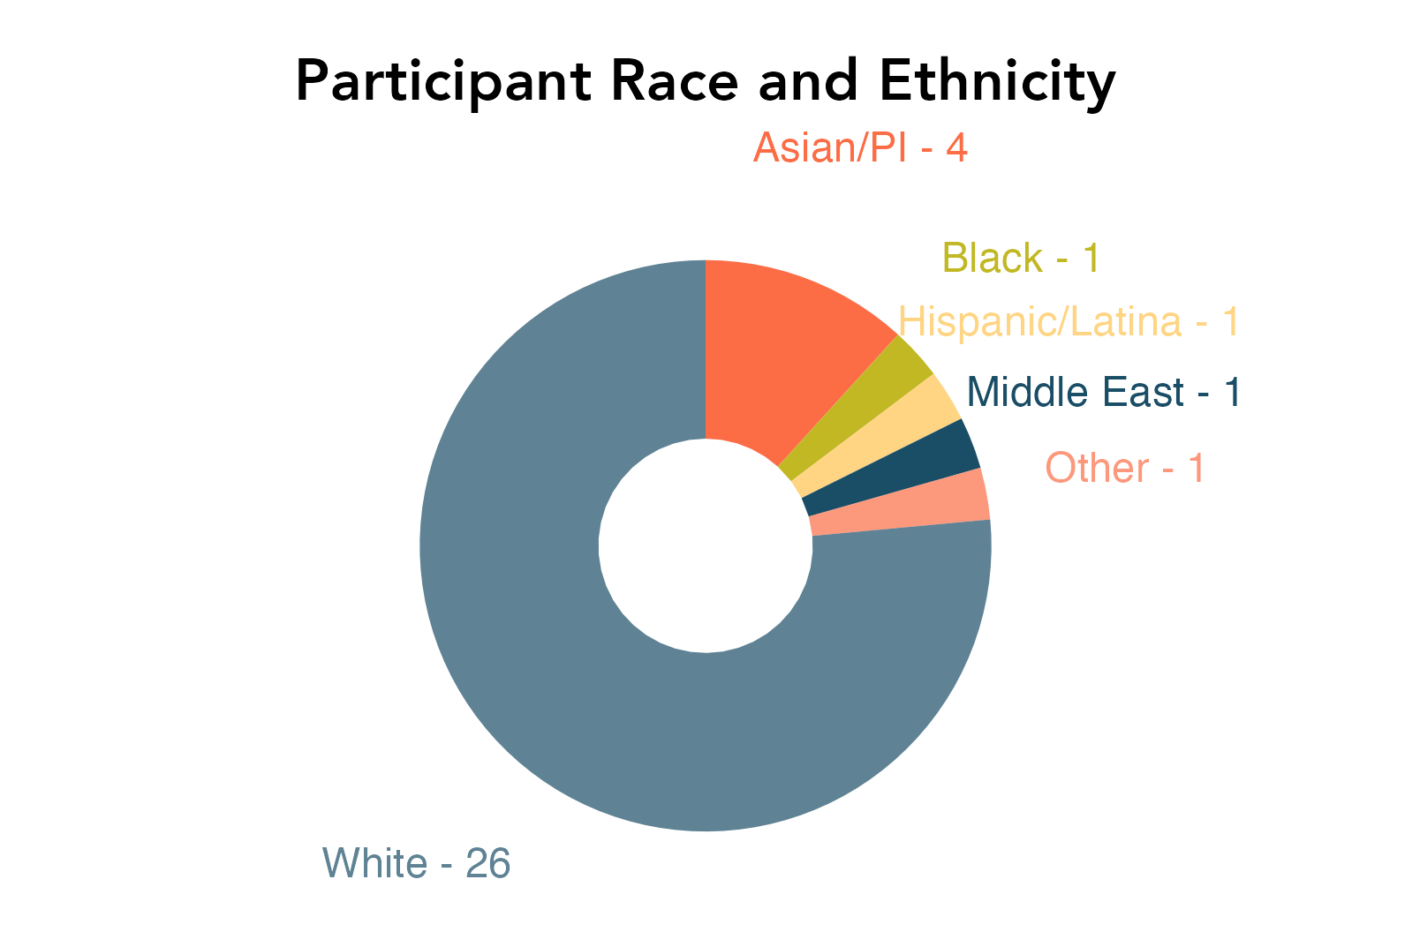
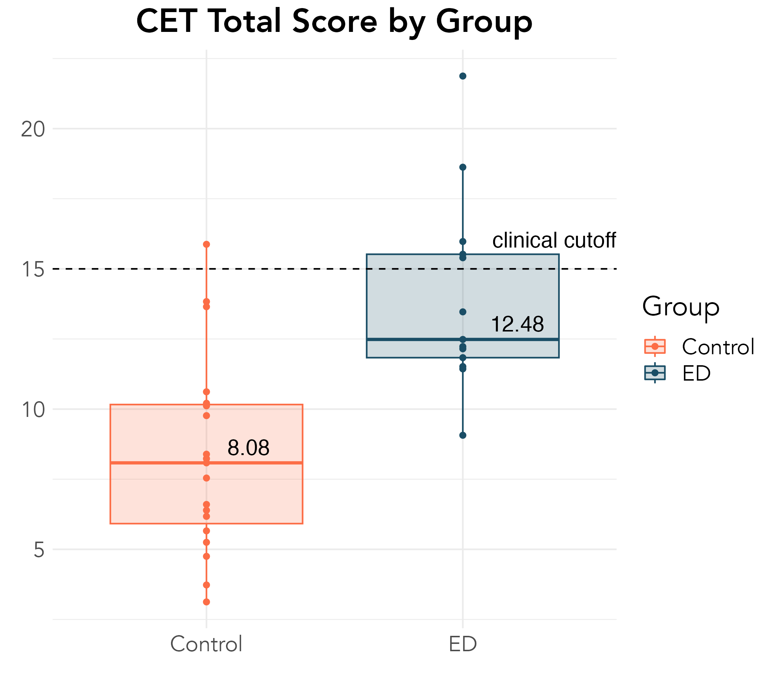
Pilot Participant Demographics
19.1 M_{age} (Range 14* - 22)
Notes:
Sample of individuals who are making choices about exercise; navigating free-living decisions

Slide 11

2a. Exercise Drive and Response

Slide 12
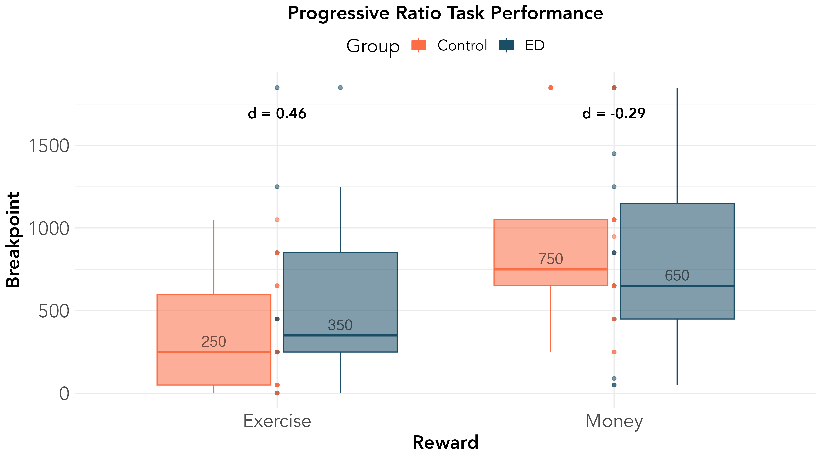
Up to 30 min/$30
.
.
.
650
.
.
450
.
.
250
.
.
50
3min/$3 for each

Slide 13
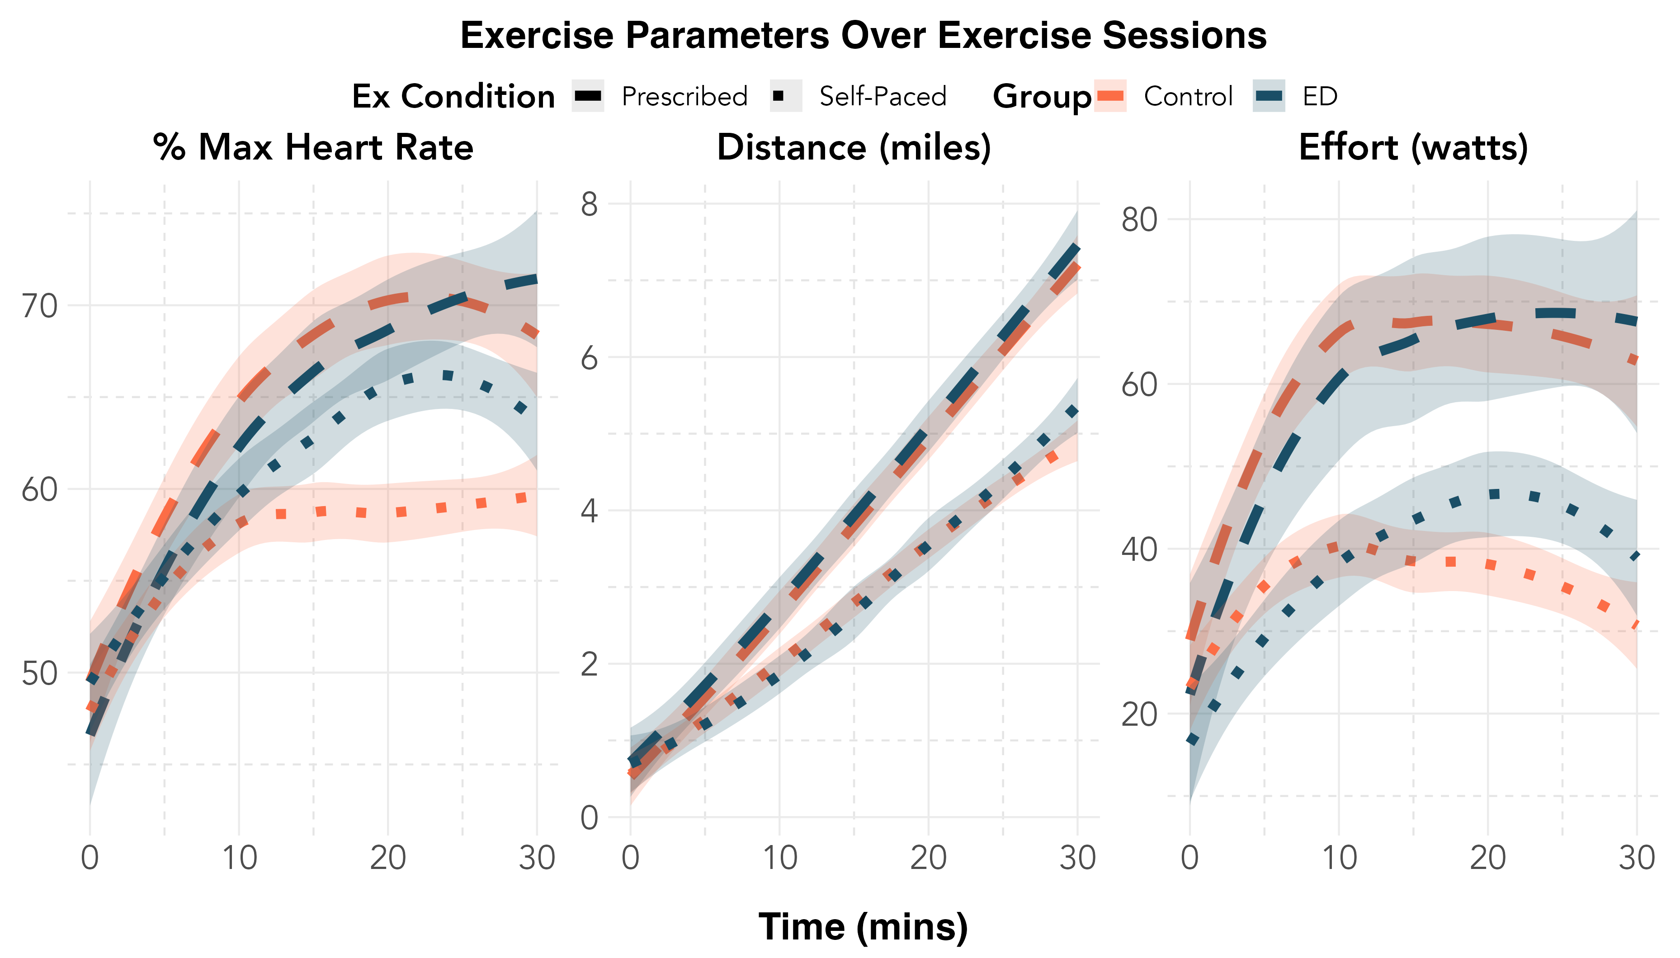

Slide 14
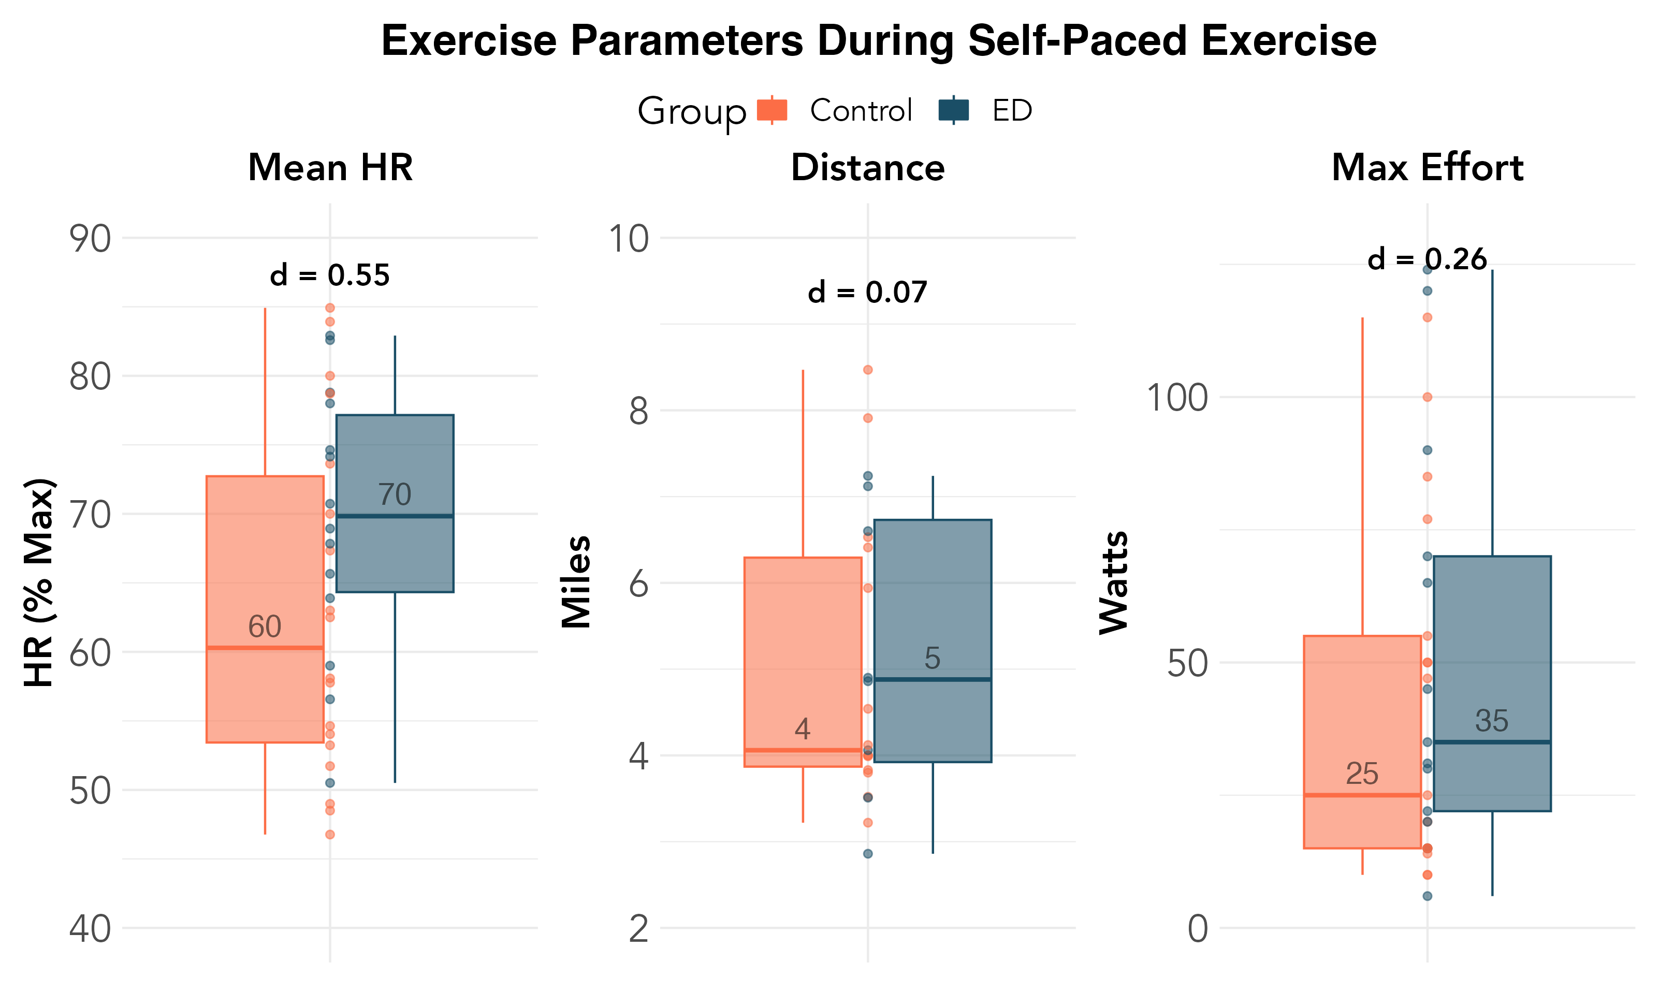

Slide 15
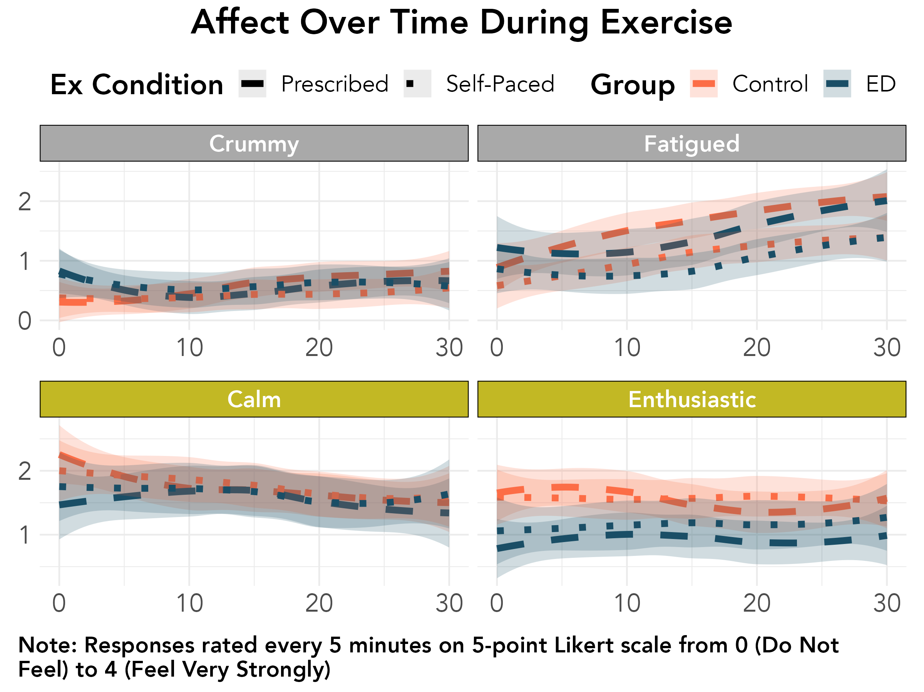

Slide 16
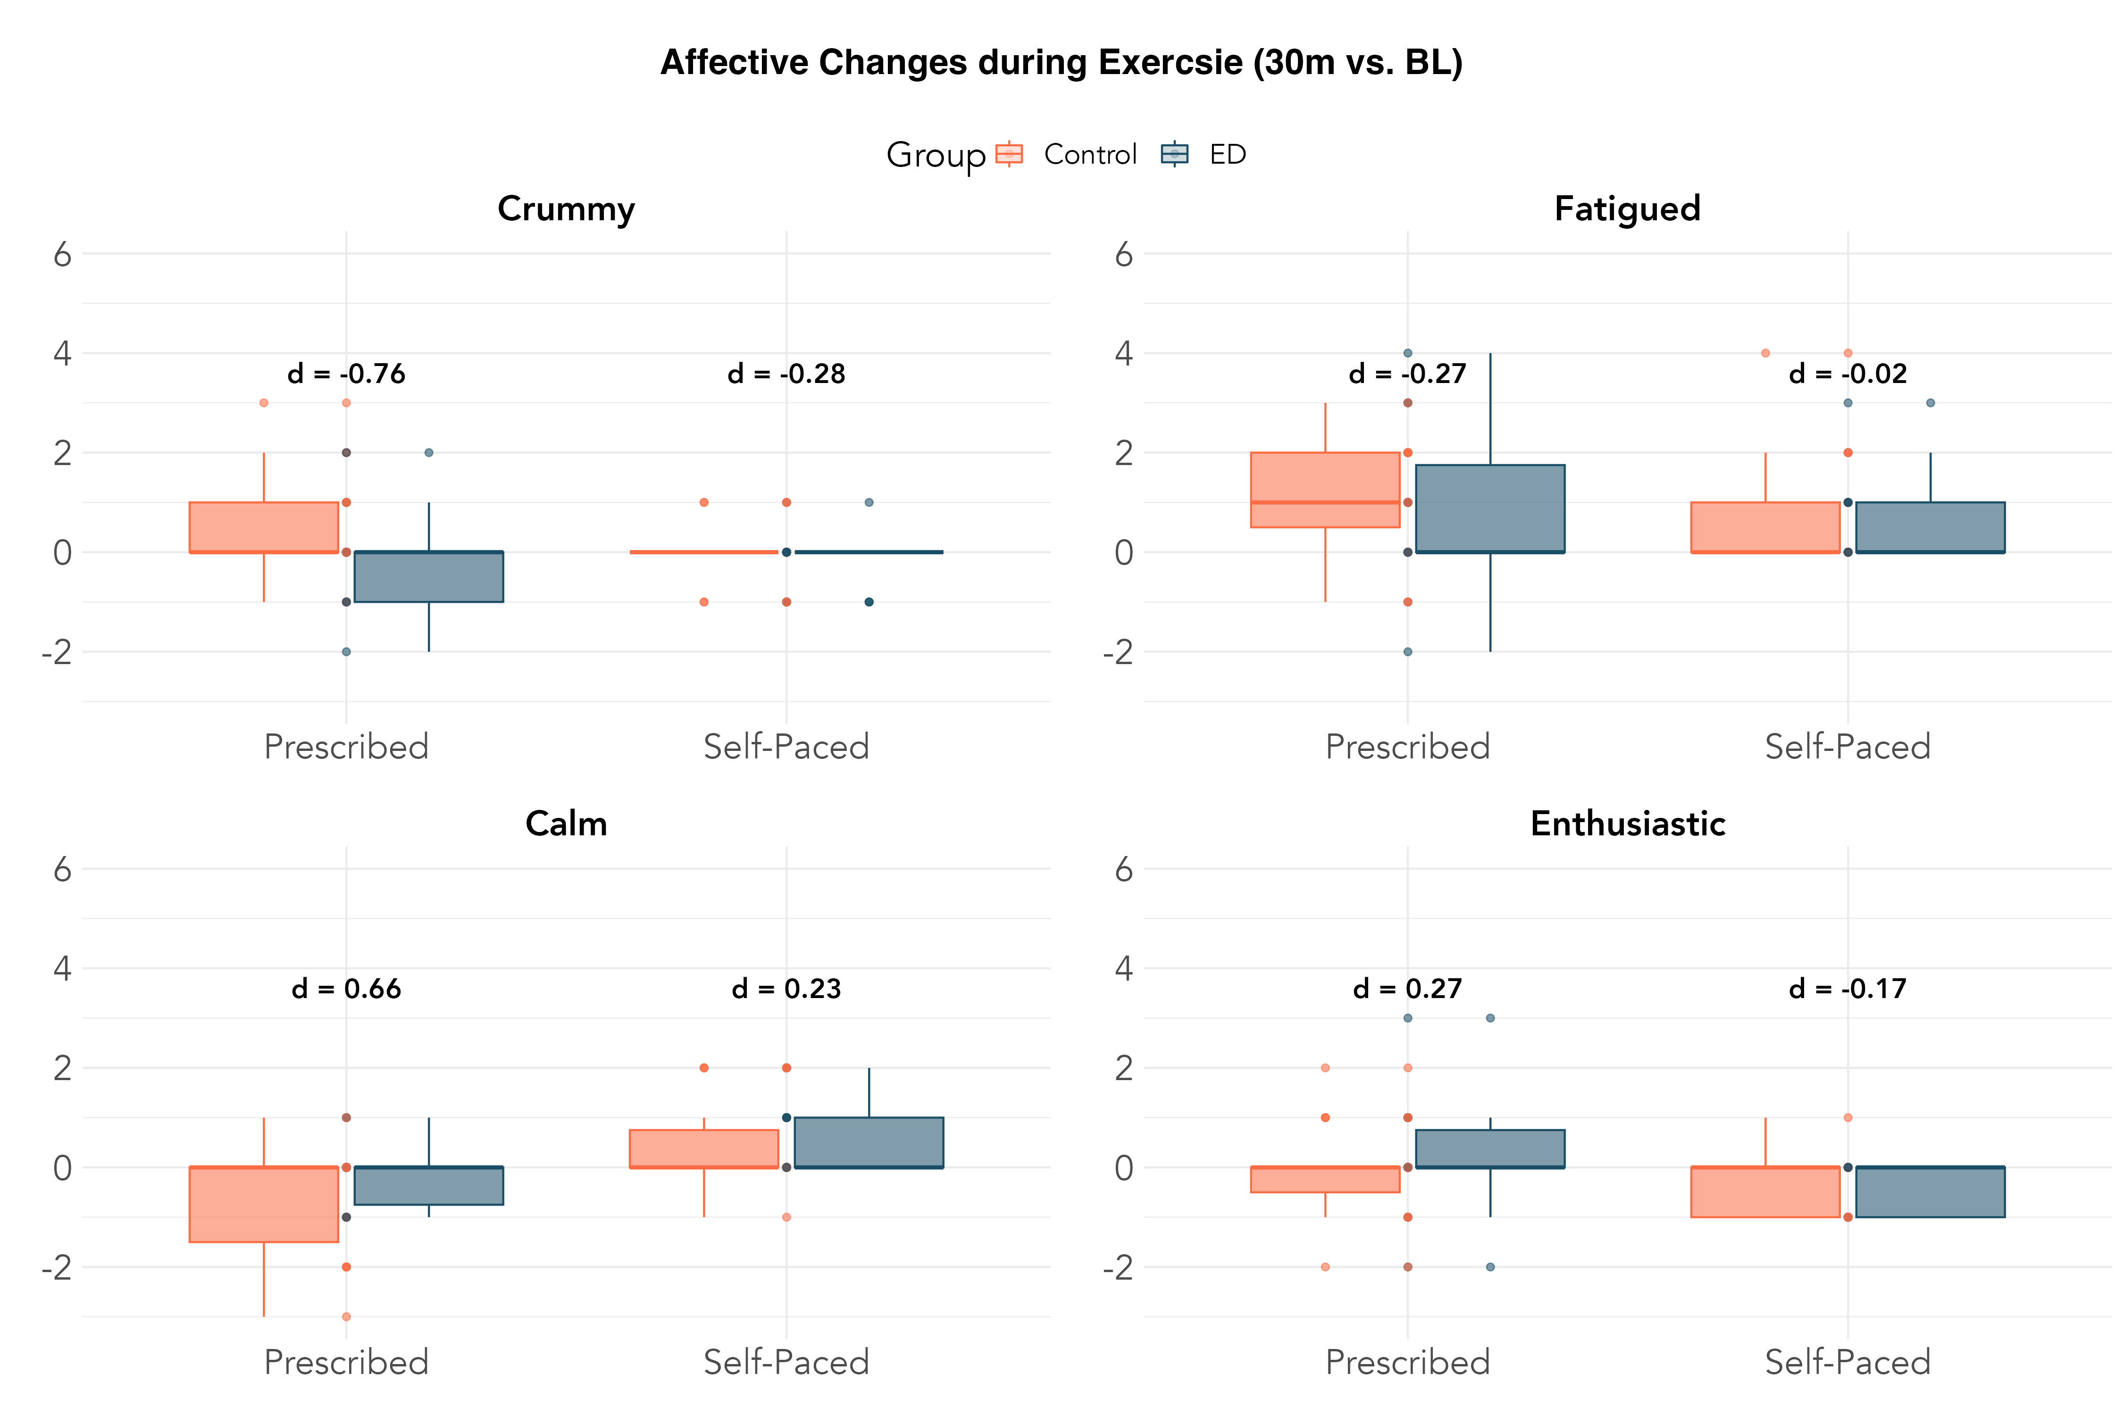

Slide 17
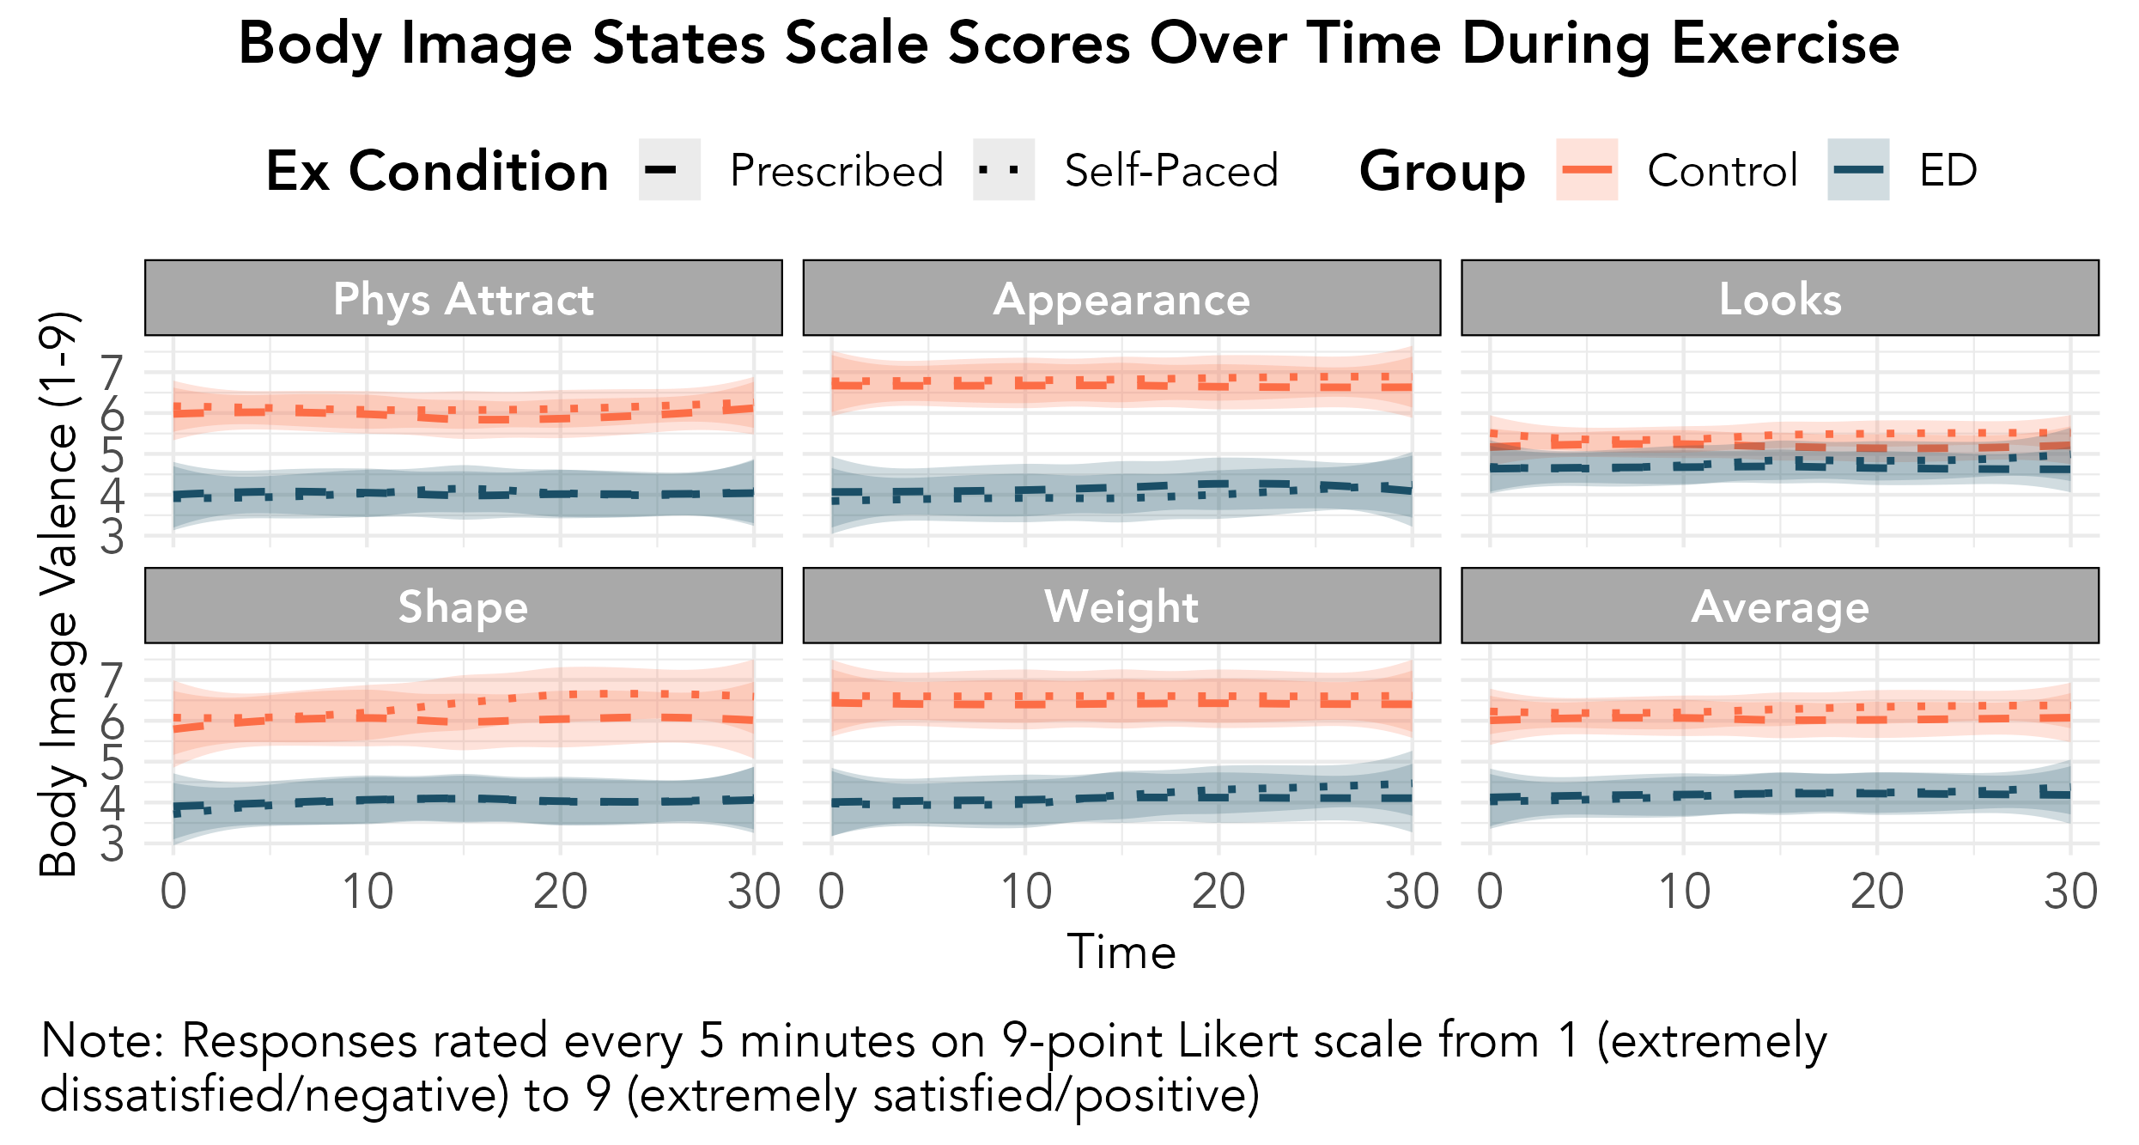

Slide 18
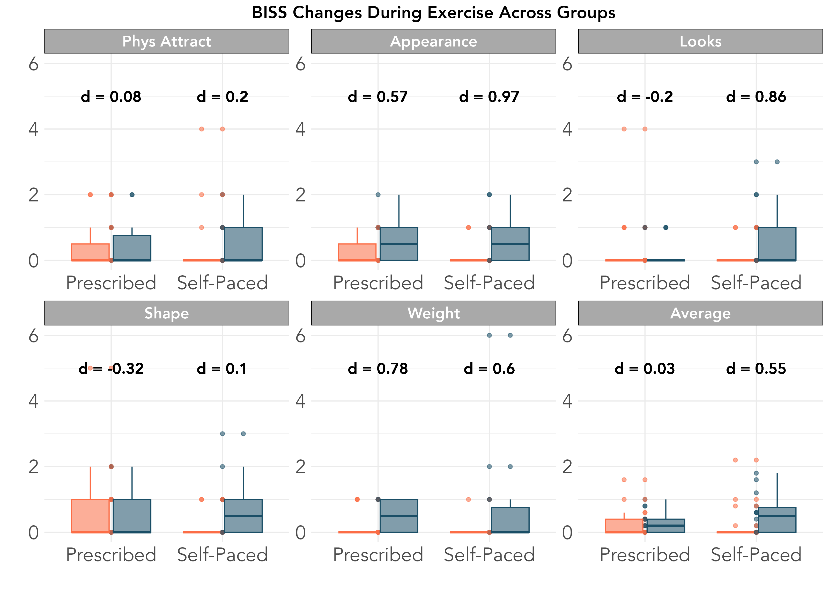

Slide 19

2b. Associations with Self-Reported Compulsive Exercise

Slide 20
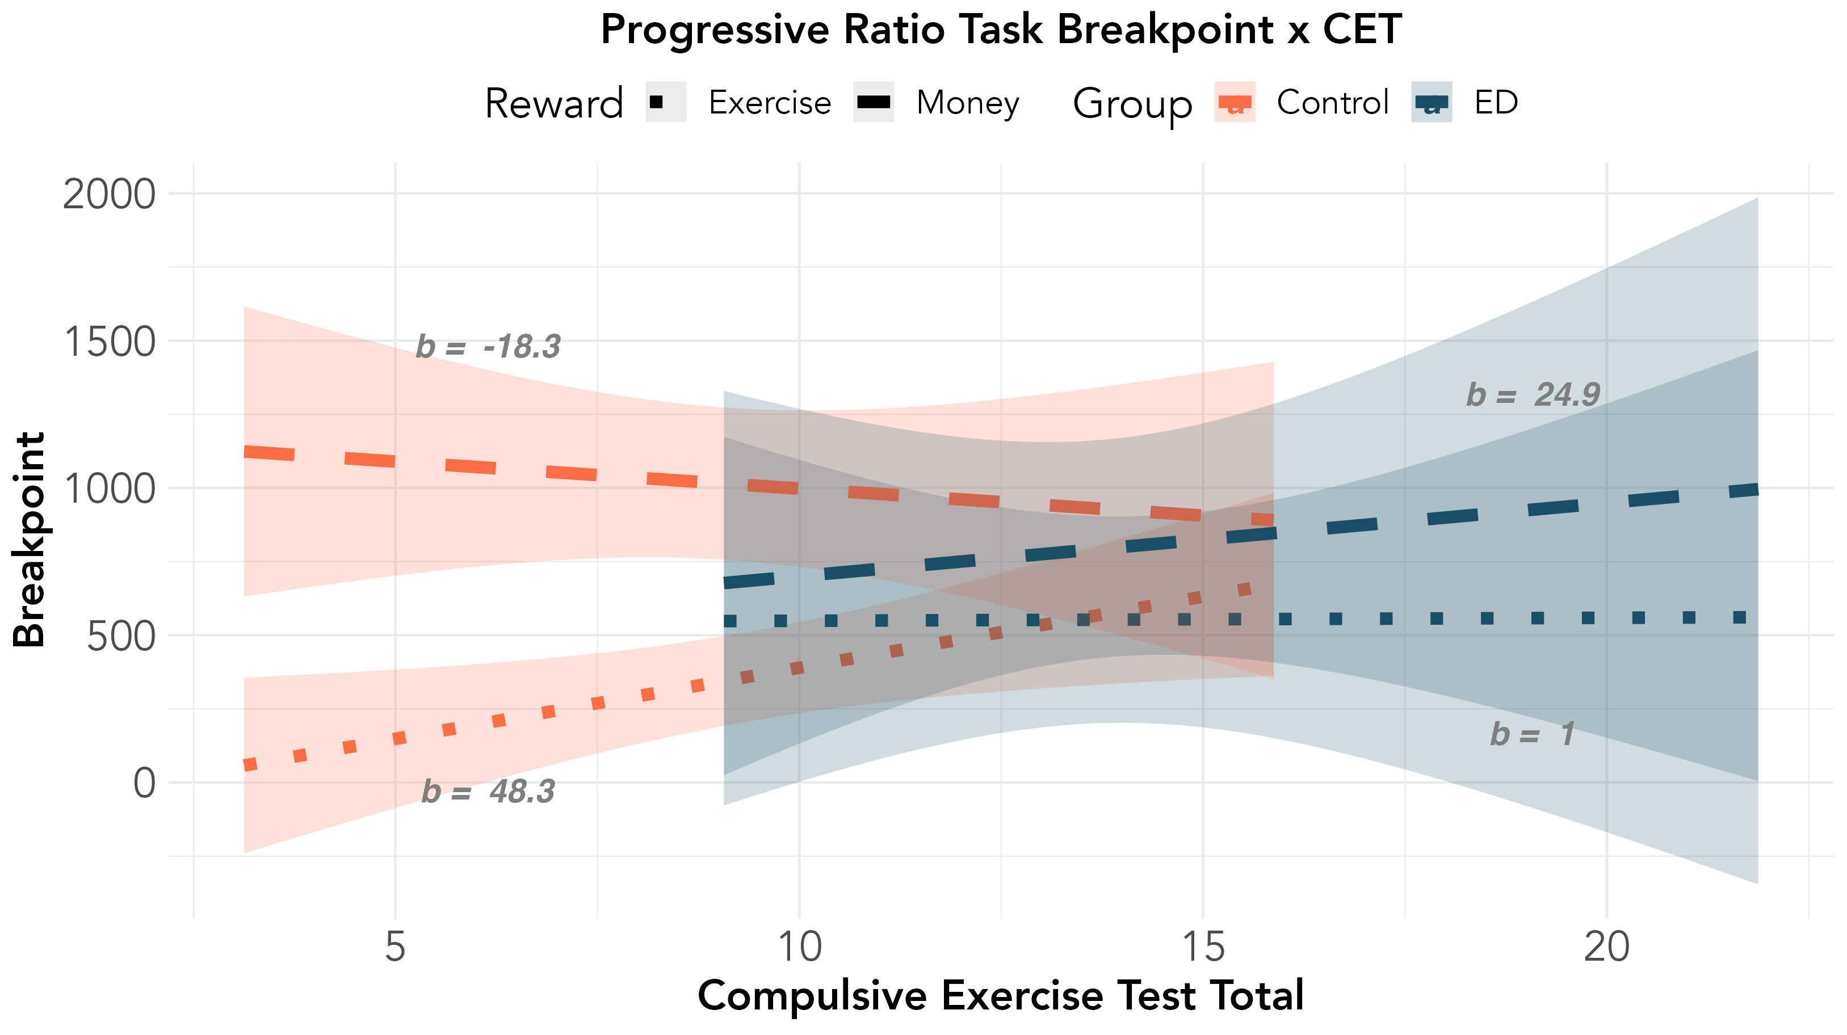

Slide 21
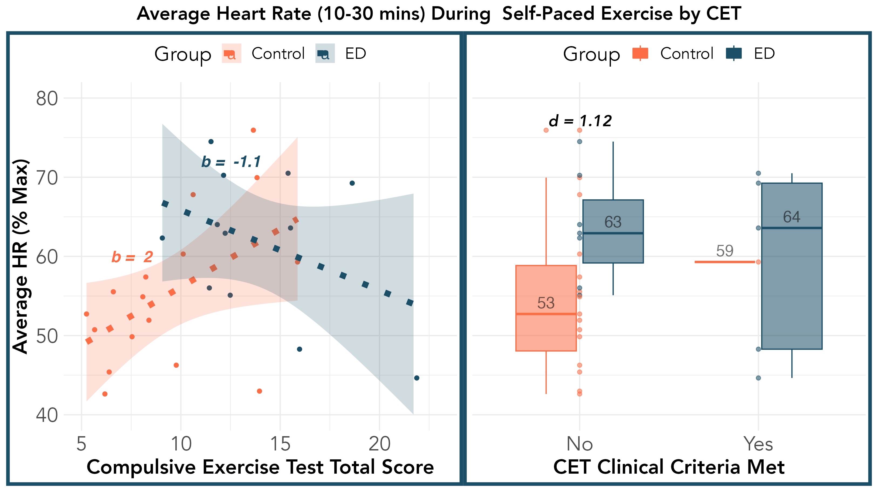

Slide 22
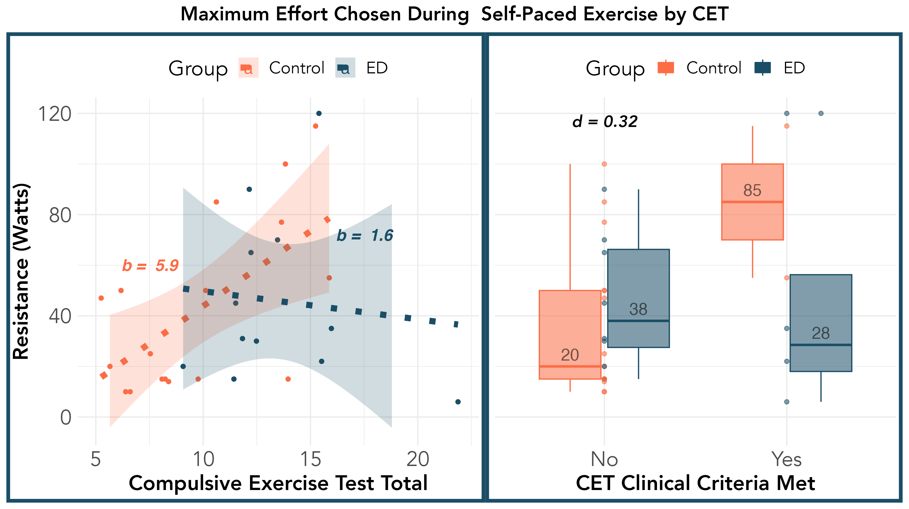

Slide 23
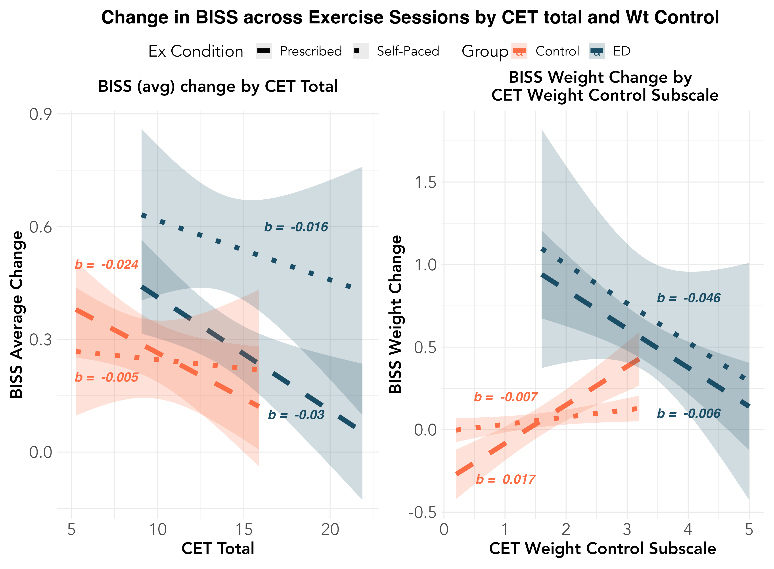

Slide 24

Takeaways
Initial evidence supports that adolescents and young adults with restrictive-spectrum EDs may be more motivated to exercise, and choose to exercise at greater intensity
Affective and body image impacts of acute exercise are occurring in expected directions in the pilot sample
Self-reported compulsive exercise aligns with exercise response among controls; no initial indications of association with exercise response among ED.
Small N – high CET exerting influence
If remains consistent – highlights distinction between exercise-related cognitions and exercise behavioral response

Slide 25
Future Work
Continue to develop and diversify samples for inferential analysis in upcoming R21 project (N = 100 [66 ED] across two sites)
Examine impacts of exercise on key biomarkers
Define biomarker associations with cognitive, affective, and behavioral measures of acute exercise drive and response

Slide 26
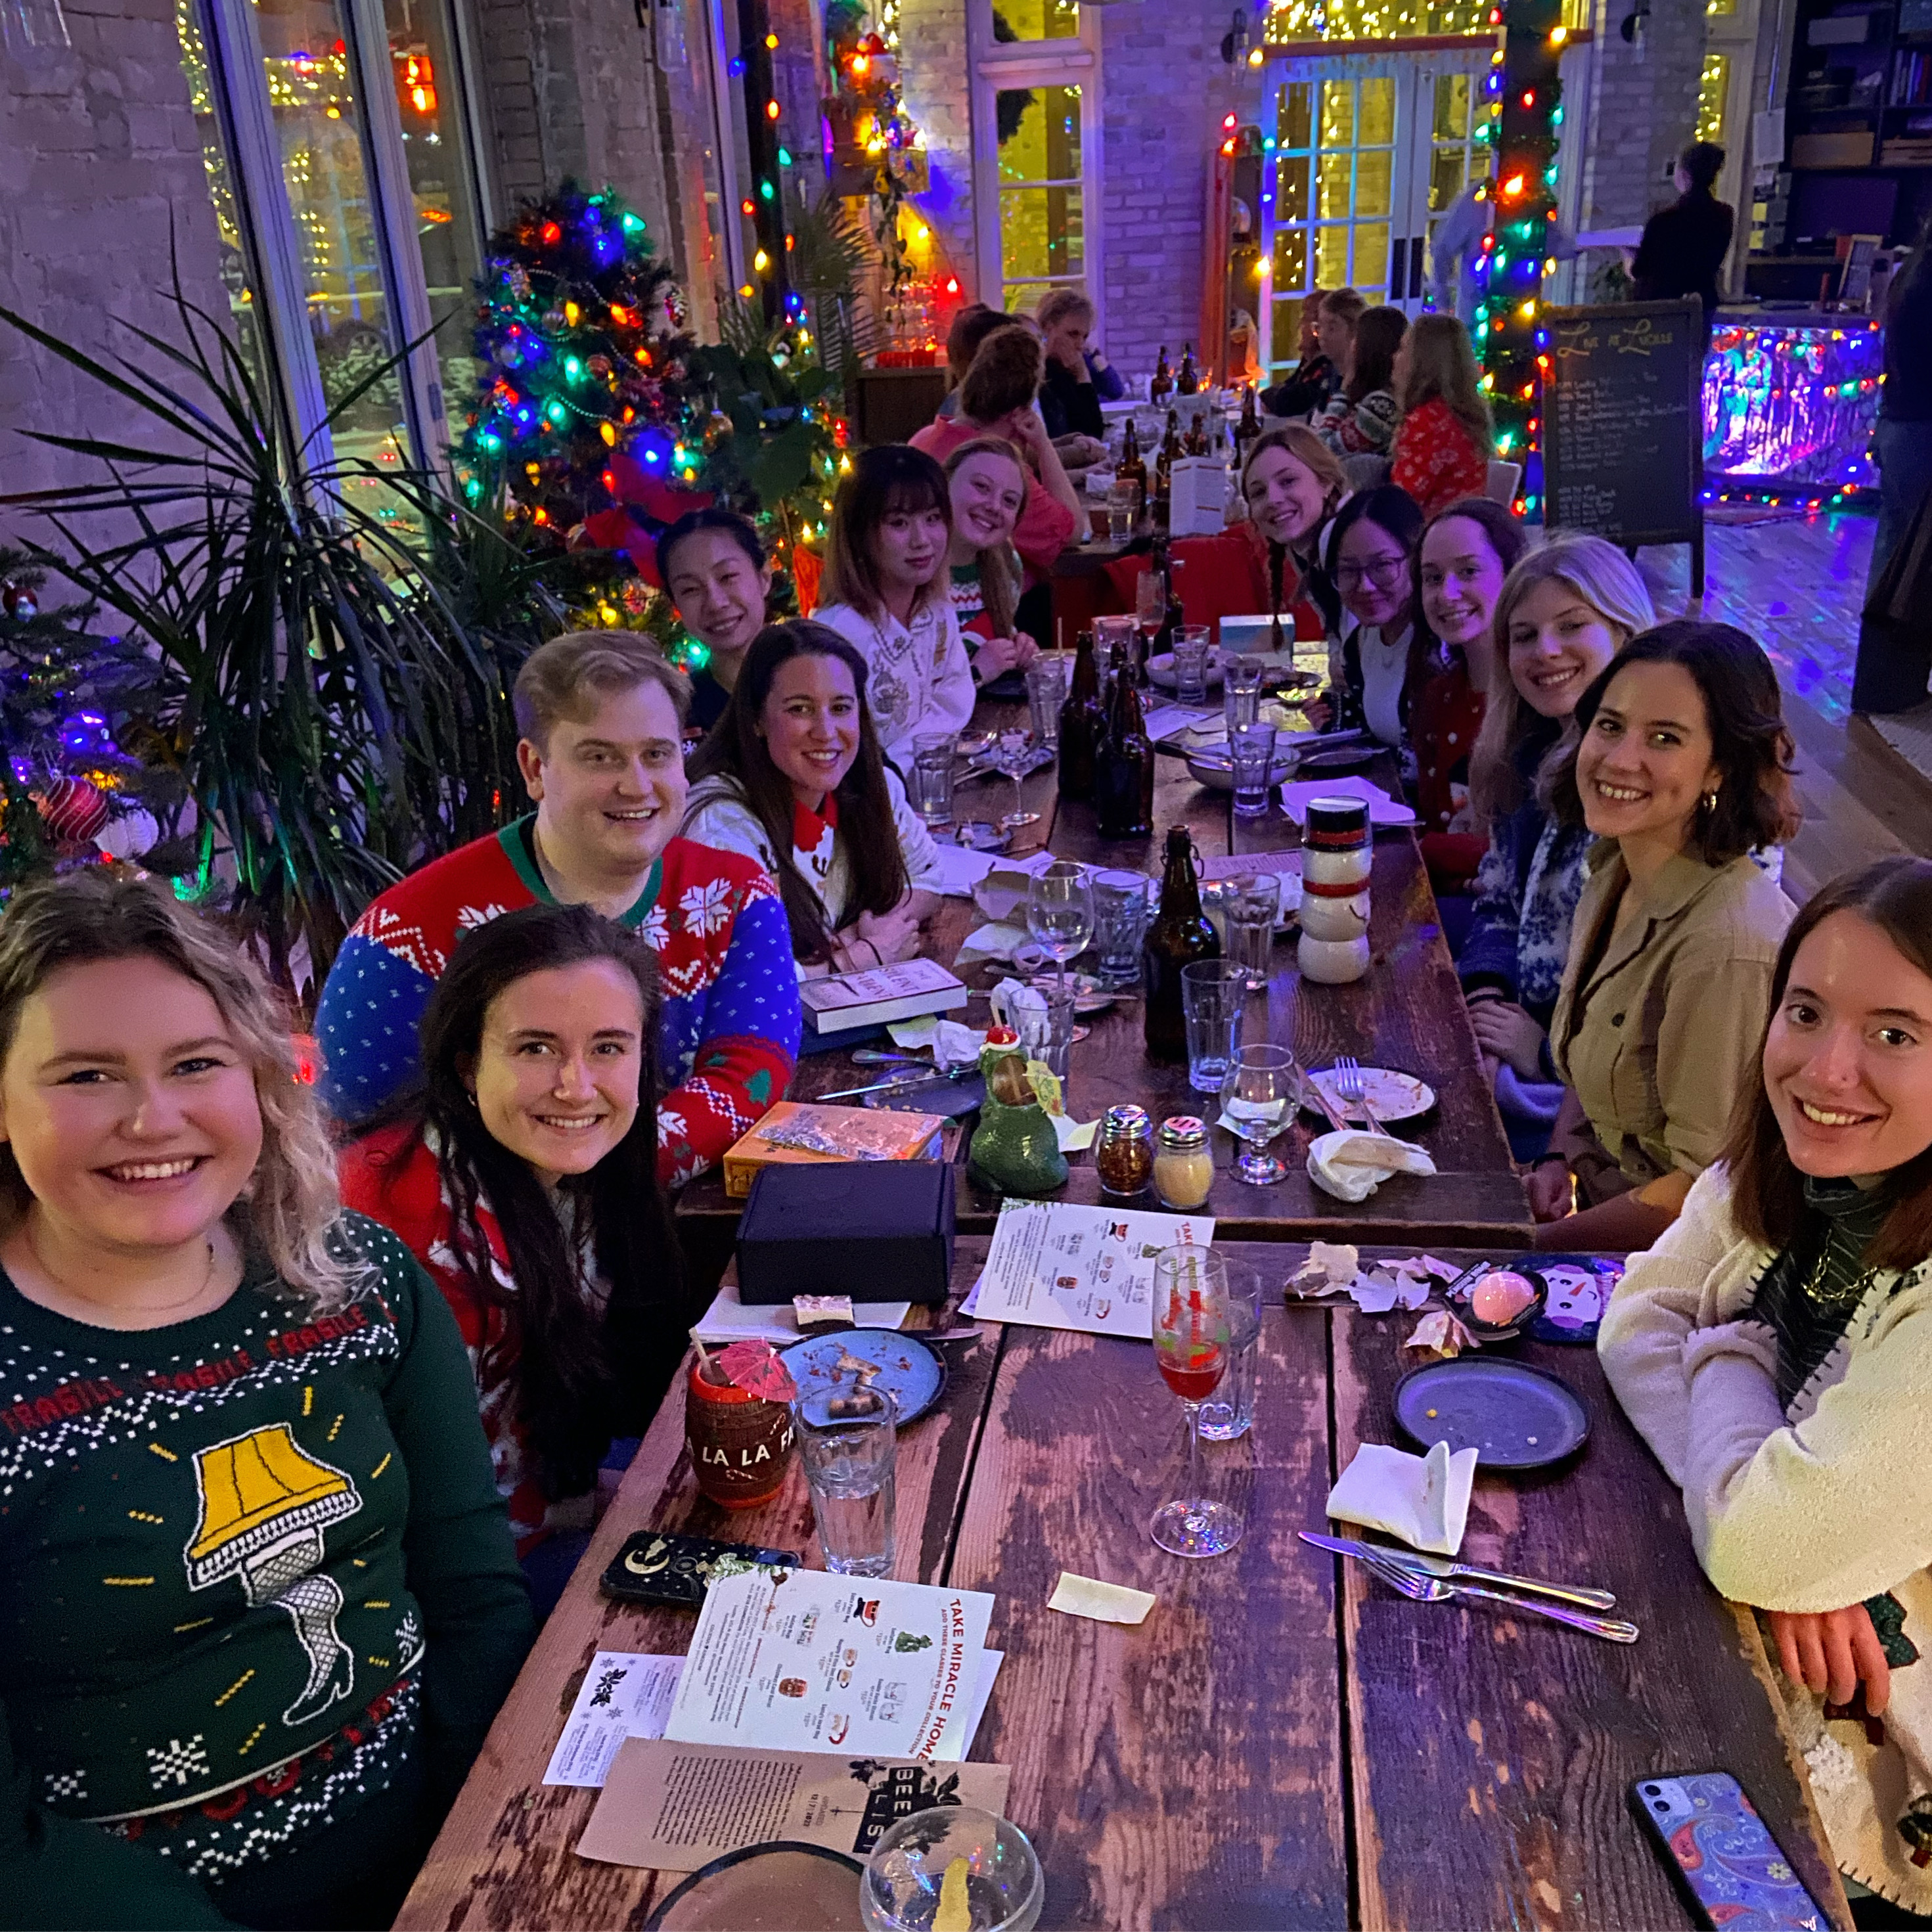
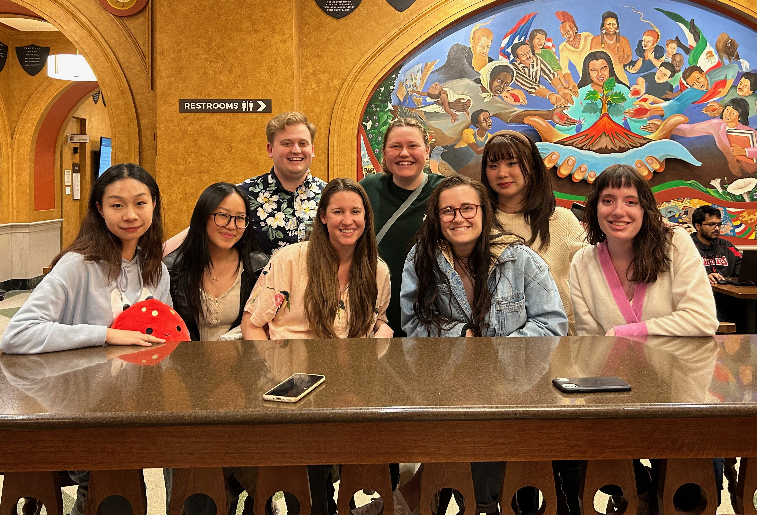
Many Thanks!
Funders
Virginia Horne Henry Fund for Women’s Exercise and Movement
K01MH123914
Study Team
Lauren Pictor
Max Frank
Sarah Niemi
Mahathi Gavuji
Danielle Lennon
Dani Peters
Rachel Ahrenholtz
Kevin Crombie
Sasha Gorrell
Stephanie Pham
Michaela Blakeslee
EMBARK lab research assistants
Mentors
K mentors (Nadia Micali; Cindy Bulik; Dane Cook)
Recruitment
John Stephenson Teenage and Young Adult Clinic Staff

